Slide 1
React - Session 1
Atul Khandelwal

Slide 2

What you should know?
HTML
CSS
Basic Javascript
Programming Fundamentals (Functions, Conditionals, Loops etc.)

Slide 3


What is React?
React is a JavaScript Library built and maintained by Facebook.
Used for front end web development.
React is an efficient, declarative, and flexible open-source javascript library for building simple fast, and scalable frontends of web applications.

Slide 4
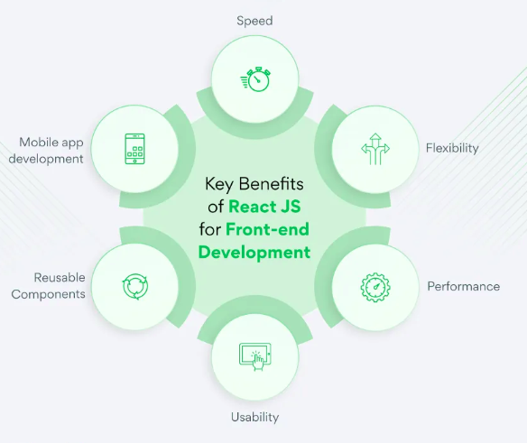
Key Benefits of React JS for Front-end Development
Data definition, organization, and storage
Event handlers respond to user actions
Resolve URLs
Interact with server(s) through APIs and AJAX

Slide 5
Fundamentals of React
JavaScript and HTML in the same file (JSX)
Virtual Dom
Functional Programming
Components, props, state

Slide 6
Introduction to jsx
JSX allows HTML (XML) and JavaScript to be combined in one file.
Allows for faster development.
JSX follows rules
Return a single root element.
All elements must be closed.
camelCase all most of the things.
Browsers do not natively support JSX.
JSX must be converted to HTML and JavaScript through the build process.
Several tools exist for managing this process including Vite, Webpack and Snowpack.

Slide 7
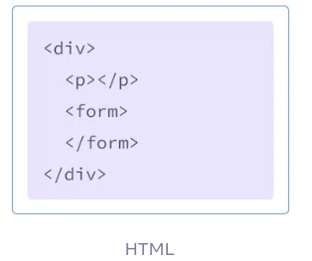
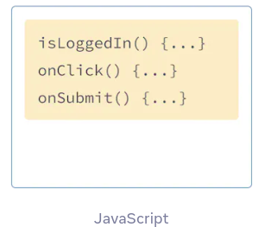
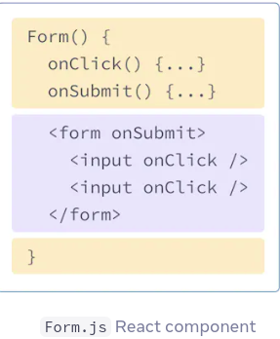
JSX: Example
);

Slide 8
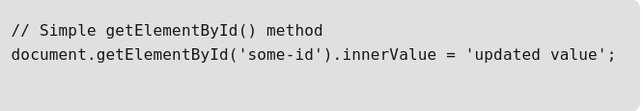
What is DOM?
DOM refers to the Document Object Model that represents the content of XML or HTML documents as a tree structure so that the programs can be read, accessed and changed in the document structure, style, and content.
The browser parses the HTML to find the node with this id.
It removes the child element of this specific element.
Updates the element(DOM) with the ‘updated value’.
Recalculates the CSS for the parent and child nodes.Update the layout.
Finally, traverse the tree and paint it on the screen(browser) display.

Slide 9
Why Virtual DOM?
Recalculating the CSS and changing the layouts involves complex algorithms, and they do affect the performance. So React has a different approach to dealing with this, as it makes use of something known as Virtual DOM.
What is Virtual DOM ?
React uses Virtual DOM exists which is like a lightweight copy of the actual DOM.
Manipulating DOM is slow, but manipulating Virtual DOM is fast as nothing gets drawn on the screen. So each time there is a change in the state of our application, the virtual DOM gets updated first instead of the real DOM.

Slide 10
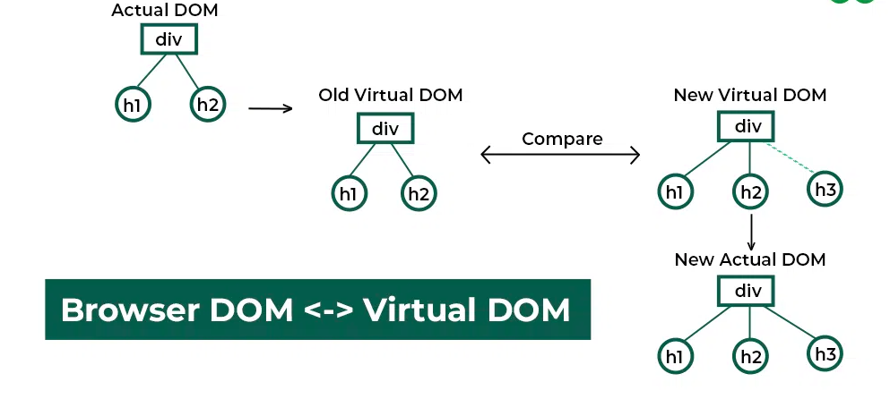
Virtual DOM

Slide 11
Functional programming
Functions are “first class citizens”.
Variables are immutable.
Functions have no side effects.

Slide 12
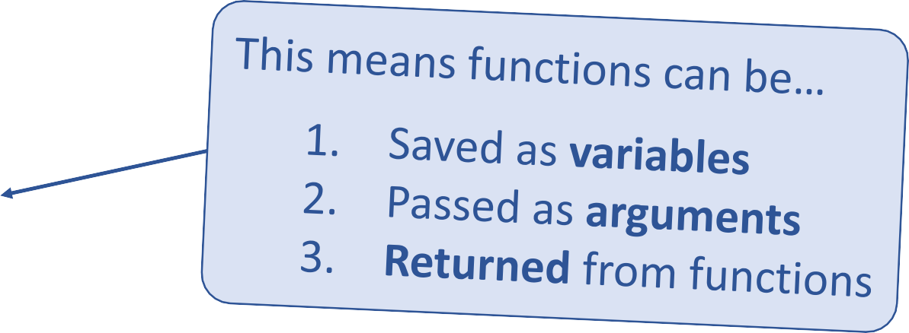
Functional Programming
Functions are “first class citizens”.
let add = function() {
const five = 3 + 2;
console.log('Now adding numbers')
};
function foo() {
return function() {
console.log('What gets printed?');
};
}
foo foo(); foo()();
Function performTask(task) { task();
console.log('Task performed!');
}
performTask(add);

Slide 13
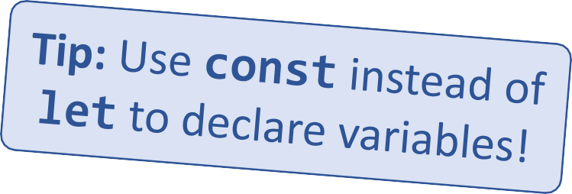
Functional Programming
Variables are immutable.
let a = 4;
a = 2; // Mutates `a`
let b = [1, 2, 3];
b.push(4); // Mutates `b`
let c = [...b, 4]; // Does not mutate `b`

Slide 14
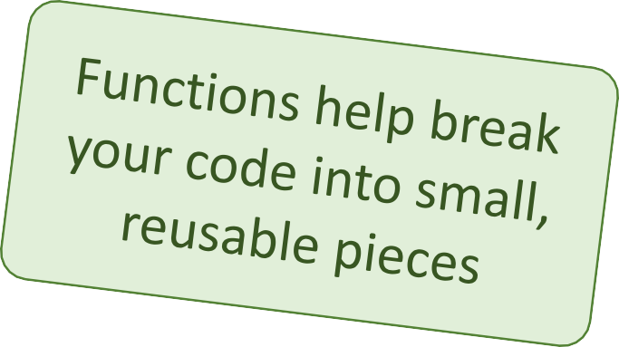
Components
Components are functions for user interfaces.
Input x
Output number
Math function:
let y = f(x);
Input x
Output HTML
Component function:
let y = <FancyDiv value={x} />;

Slide 15

“In React, everything is a component”

Slide 16
Anatomy of a React component
The component is just a function.
Inputs are passed through a single argument called “props”
The function outputs HTML
export default function MyComponent(props) {
return <div>Hello, world! My name is {props.name}</div>;
}
const html = <MyComponent name="aaron" />;
The function is executed as if it was an HTML tag
Parameters are passed in as HTML attributes

Slide 17
Component rendering
When a component function executes, we say it “renders”.
Assume components may re-render at any time.
Our job is to ensure that every time the component re-renders, the correct output is produced.

Slide 18
What are hooks?
Hooks: Special functions that allow developers to hook into state and lifecycle of React components.
Built-in hooks:
useState
We will cover these today
State: One or more data values associated with a React component instance.
useEffect
useReducer
We will not cover
these today
useMemo
Lifecycle: The events associated with a React component instance (create, render, destroy, etc).
useRef
useCallback

Slide 19
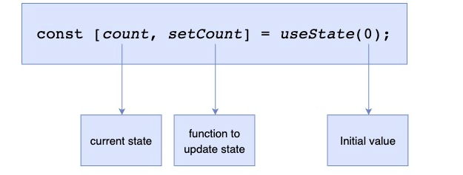
First React hook: useState
Purpose:
Remember values internally when the component re-renders
Tell React to re-render the component when the value changes
Syntax:

Slide 20
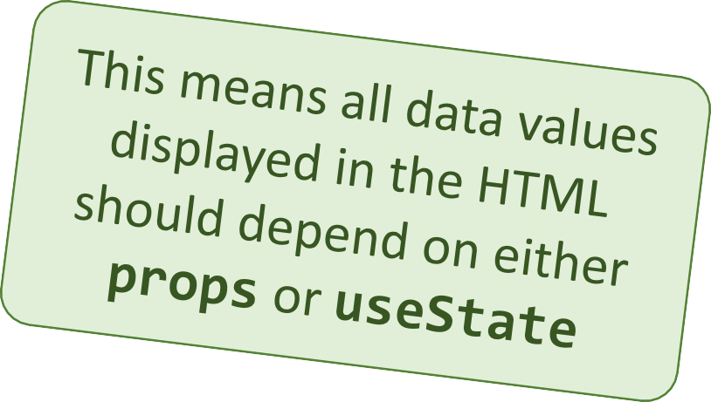
Predicting component re-rendering
A component will only re-render when…
A value inside props changes
– or –
A useState setter is called

Slide 21



Second React hook: useEffect
Purpose:
Act as an observer, running code in response to value changes.
Syntax:
A list of values such that changes should trigger this code to run

Slide 22
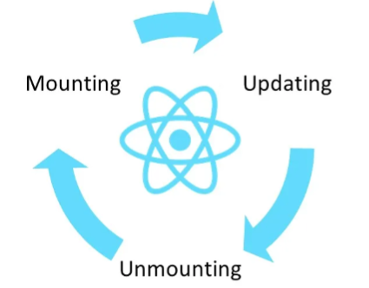
REACT COMPONENT LIFECYCLE
There are 3 phases in the React Component Lifecycle
Mounting Phase
Updating Phase
Un mounting Phase

Slide 23
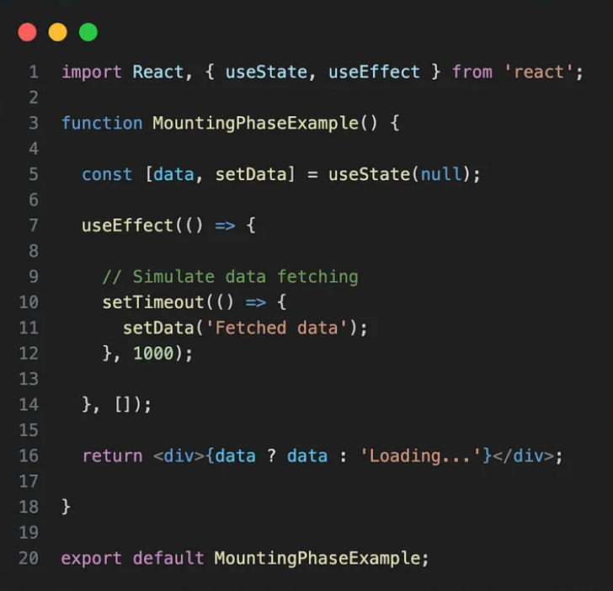
Mounting Phase
A Functional component is being
Created and added to the DOM.
In this phase , you typically initialise
state and perform any setup that's
needed when the component is first
rendered.

Slide 24
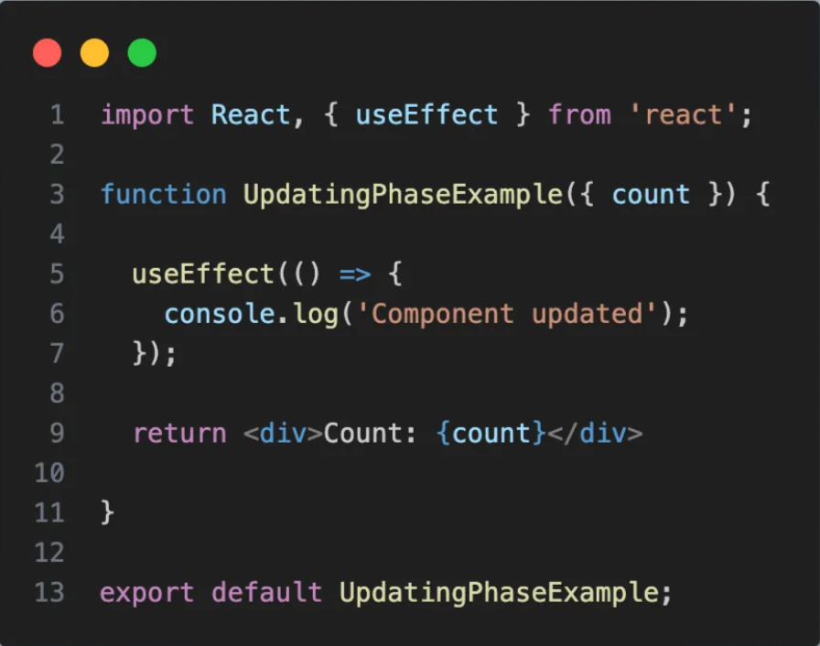
Updating Phase
In this phase , the functional component is re-rendered due to change in its props or state.

Slide 25
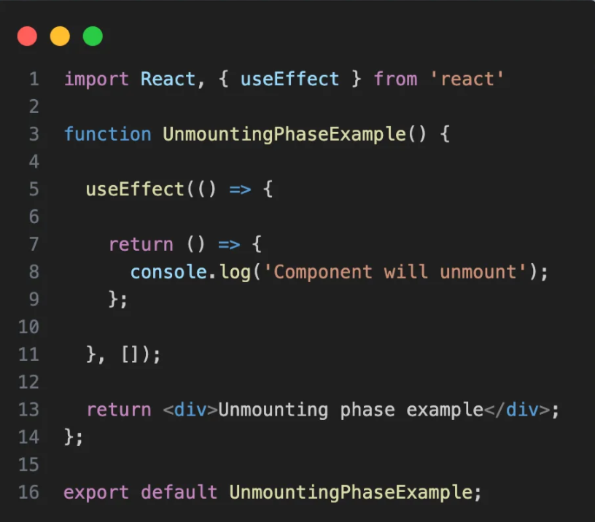
Un-Mounting Phase
In the unmounting phase, the functional component is being removed from the DOM. The cleanup function in the useEffect hook simulates the behaviour of componentWillUnmount.

Slide 26
Creating a new React app
Creating a new React app is simple!
Install Node.js
Run: npx create-react-app app-name
New app created in folder: ./app-name

Slide 27
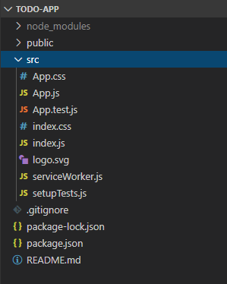
Anatomy of a new React app
public holds the initial html document and other static assets
App is a boilerplate starter component
index.js binds React to the DOM
package.json configures npm dependencies

Slide 28
Building a React project
When you’re ready to launch your app, run this command:
npm run build
This bundles your app into CSS/JS/HTML files and puts them in the
/build folder
These files can be served from an AWS S3 bucket

Slide 29
3rd party components and libraries
React-Router
Redux
Material-UI
Bootstrap
Font-Awesome

Slide 30
THANK YOU

